Slide 1
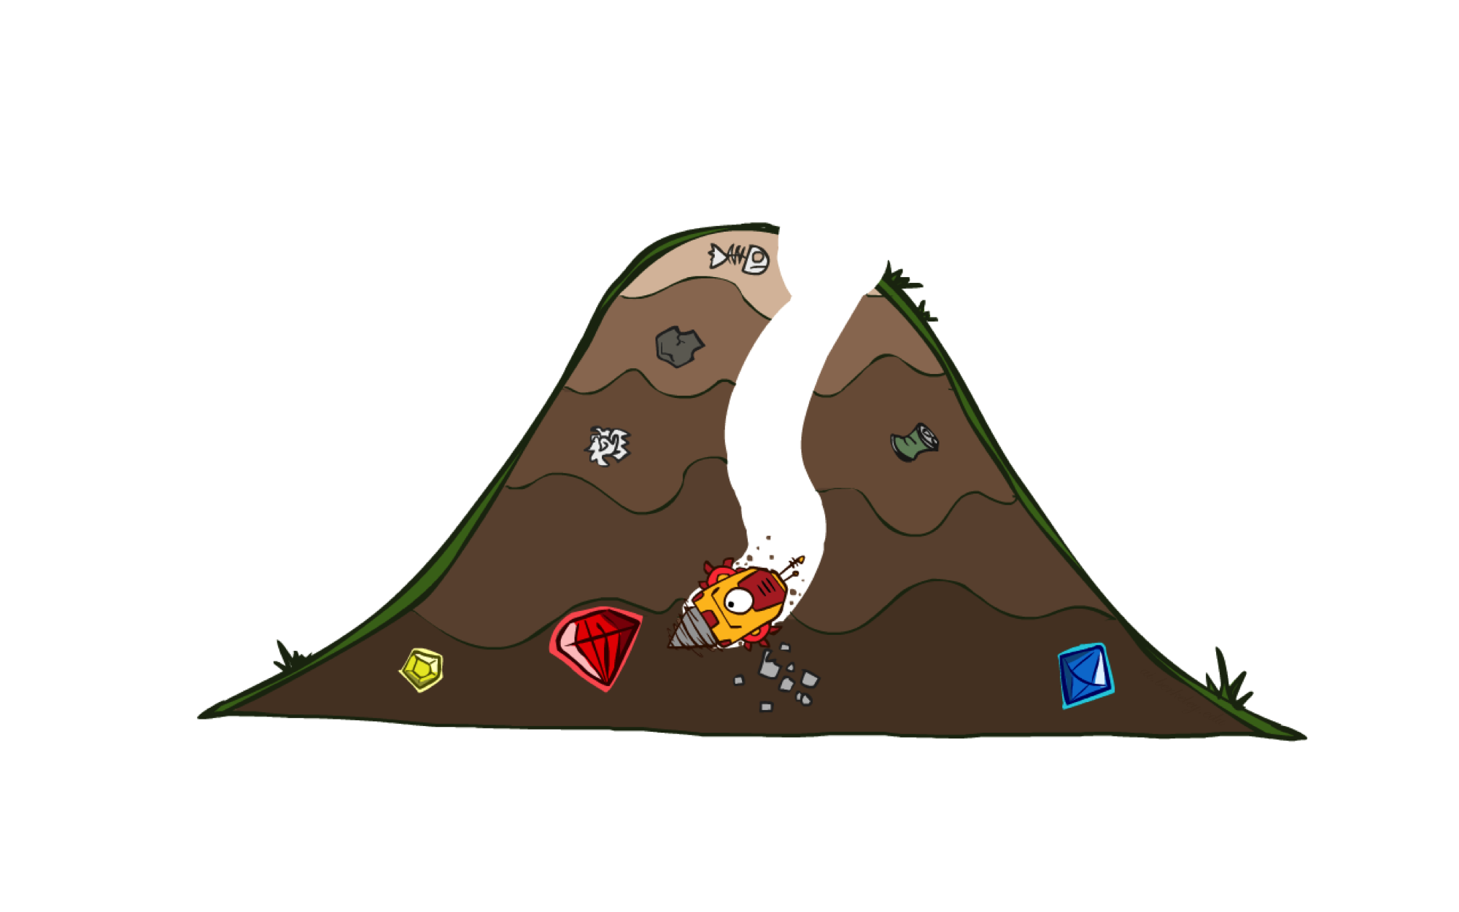
Informed Search - II
A* Search Algorithm

Slide 2
Previous Lecture
Heuristics
Greedy Search

Slide 3
A* Search
eval-fn: $f(n)=g(n)+h(n)$

Slide 4
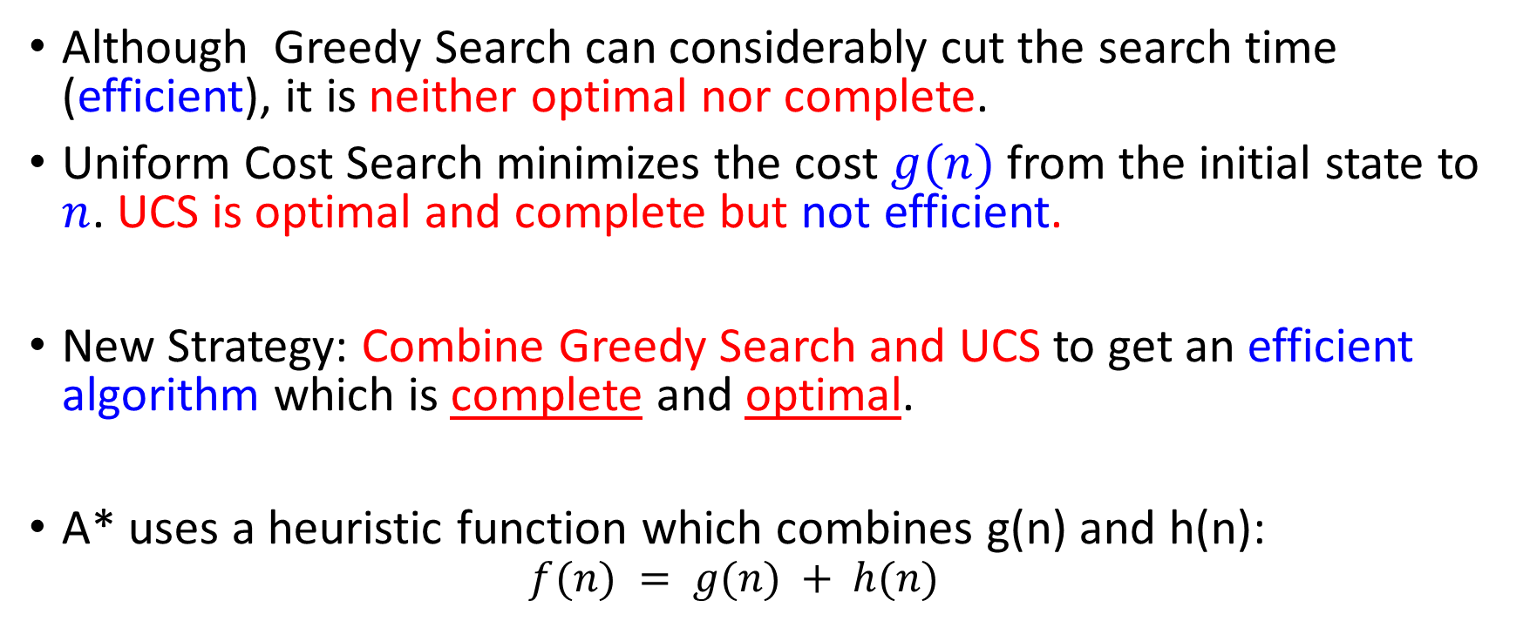
A* (A Star)
Although Greedy Search can considerably cut the search time (efficient), it is neither optimal nor complete.
Uniform Cost Search minimizes the cost $g(n)$ from the initial state to $n$. UCS is optimal and complete but not efficient.
New Strategy: Combine Greedy Search and UCS to get an efficient algorithm which is complete and optimal.
A* uses a heuristic function which combines g(n) and h(n):
$$f(n) = g(n) + h(n)$$

Slide 5
Combining UCS and Greedy
Uniform-cost orders by path cost, or backward cost g(n)
Greedy orders by goal proximity, or forward cost h(n)
A* Search orders by the sum: f(n) = g(n) + h(n)
8
g = 0 h=6
S
e
h=1
g = 1 h=5
a
1
1
3
2
g = 2 h=6
g = 9 h=1
S
a
d
G
b
d
g = 4 h=2
e
h=6
1
h=5
h=2
h=0
1
g = 3 h=7
g = 6 h=0
g = 10 h=2
c
b
c
G
d
h=7
h=6
g = 12 h=0
G

Slide 6
A* Search
Start
State | Heuristic: h(n)
A | 366
B | 374
C | 329
D | 244
E | 253
F | 178
G | 193
H | 98
I | 0
A
75
118
140
B
C
111
E
D
80
99
G
F
97
H
211
101
I
Goal
f(n) = g(n) + h (n)
g(n): is the exact cost to reach node n from the initial state.

Slide 7
A* Search: Tree Search
A
Start

Slide 8
A* Search: Tree Search
A
Start
118
75
140
E
[140+253=393]
B
[75+374=449]
[118+329=447]
C

Slide 9
A* Search: Tree Search
A
Start
118
75
140
E
[140+253=393]
B
[75+374=449]
[118+329=447]
C
80
99
G
F
[239+178=417]
[220+193=413]

Slide 10
A* Search: Tree Search
A
Start
118
75
140
E
[140+253=393]
B
[75+374=449]
[118+329=447]
C
80
99
G
F
[239+178=417]
[220+193=413]
97
[317+98=415]
H

Slide 11
A* Search: Tree Search
A
Start
118
75
140
E
[140+253=393]
B
[75+374=449]
[118+329=447]
C
80
99
G
F
[239+178=417]
[220+193=413]
97
[317+98=415]
H
101
I
[418+0=418]
Goal

Slide 12
A* Search: Tree Search
A
Start
118
75
140
E
[140+253=393]
B
[75+374=449]
[118+329=447]
C
80
99
G
F
[239+178=417]
[220+193=413]
97
211
[317+98=415]
H
I
[450+0=450]
101
I
[418+0=418]
Goal

Slide 13
A* Search: Tree Search
A
Start
118
75
140
E
[140+253=393]
B
[75+374=449]
[118+329=447]
C
80
99
G
F
[239+178=417]
[220+193=413]
97
211
[317+98=415]
H
I
[450+0=450]
101
I
[418+0=418]
Goal

Slide 14
A* Search: Tree Search
A
Start
118
75
140
E
[140+253=393]
B
[75+374=449]
[118+329=447]
C
80
99
G
F
[239+178=417]
[220+193=413]
97
211
[317+98=415]
H
I
[450+0=450]
101
I
[418+0=418]
Goal
dist(A-E-G-H-I) =140+80+97+101=418

Slide 15

A* search example

Slide 16
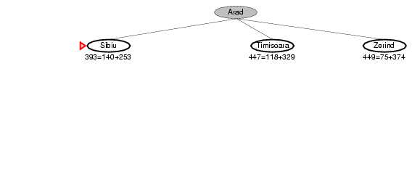
A* search example

Slide 17
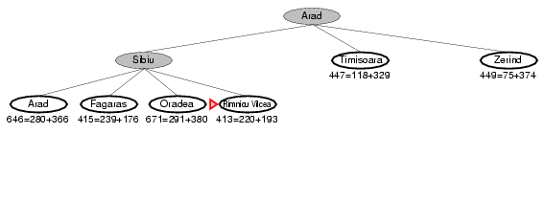
A* search example

Slide 18
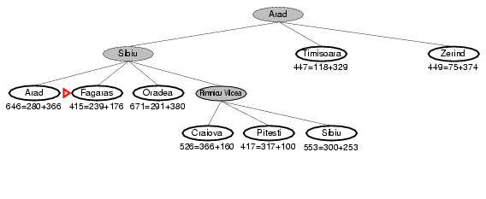
A* search example

Slide 19
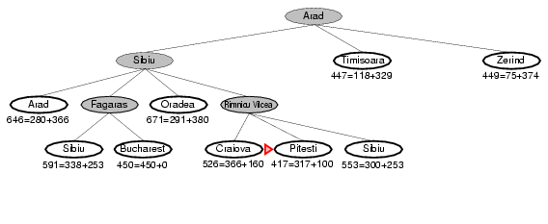
A* search example

Slide 20
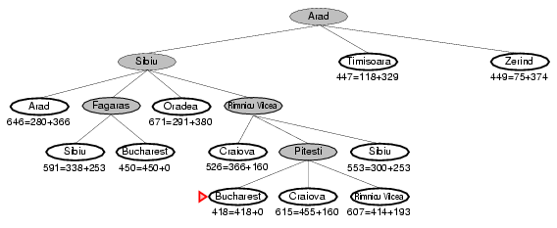
A* search example

Slide 21
Heuristic Value
S | 7
A | 6
B | 2
C | 1
D | 0
 | FRONTIER | EXPAND | EXPLORED
1 | (S,0+7=7) | S | Empty
2 | (S-A,1+6=7)(S-B,4+2=6) | B | S
3 | (S-A,7)(S-B-C,6+1=7) | A | S,B
4 | (S-A-B,3+2=5)(S-A-C,6+1=7)(S-A-D,13+0=13)(S-B-C,7) | C | S,B,A
5 | (S-A-C-D,9+0=9) | D | S,B,A,C
6 | OR (S-B-C-D,9+0=9)
7
S
1
4
2
A
B
5
12
2
C
D
3
f(n) = g(n)+h(n)

Slide 22
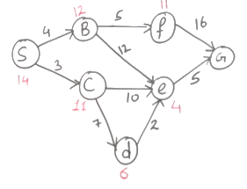

Slide 23
Is A* Optimal?
h = 6
1
A
3
S
h = 7
G
h = 0
5
What went wrong?
Actual bad goal cost < estimated good goal cost
We need estimates to be less than actual costs!

Slide 24
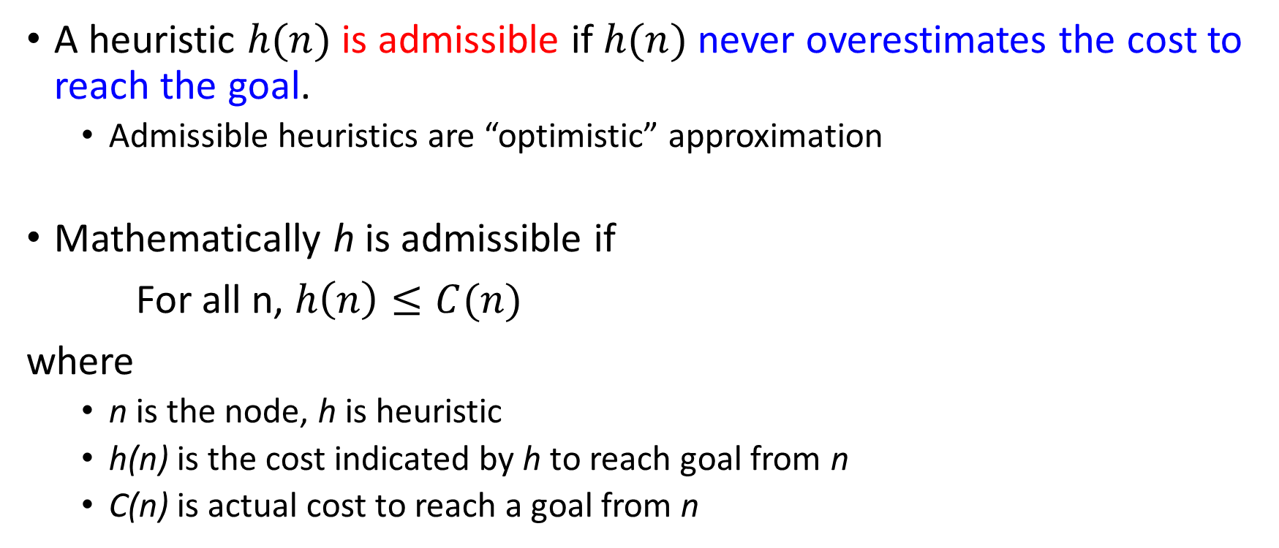
Admissible Heuristic Functions
A heuristic $h(n)$ is admissible if $h(n)$ never overestimates the cost to reach the goal.
Admissible heuristics are “optimistic” approximation
Mathematically h is admissible if
For all n, $h\left(n\right)≤C(n)$
where
n is the node, h is heuristic
h(n) is the cost indicated by h to reach goal from n
C(n) is actual cost to reach a goal from n

Slide 25

Admissible heuristics Examples
$h_{SLD}\left(n\right)$ Straight line distance heuristic
Because never overestimate the actual road distance.
Number of misplaced tiles in n-puzzle problem

Slide 26
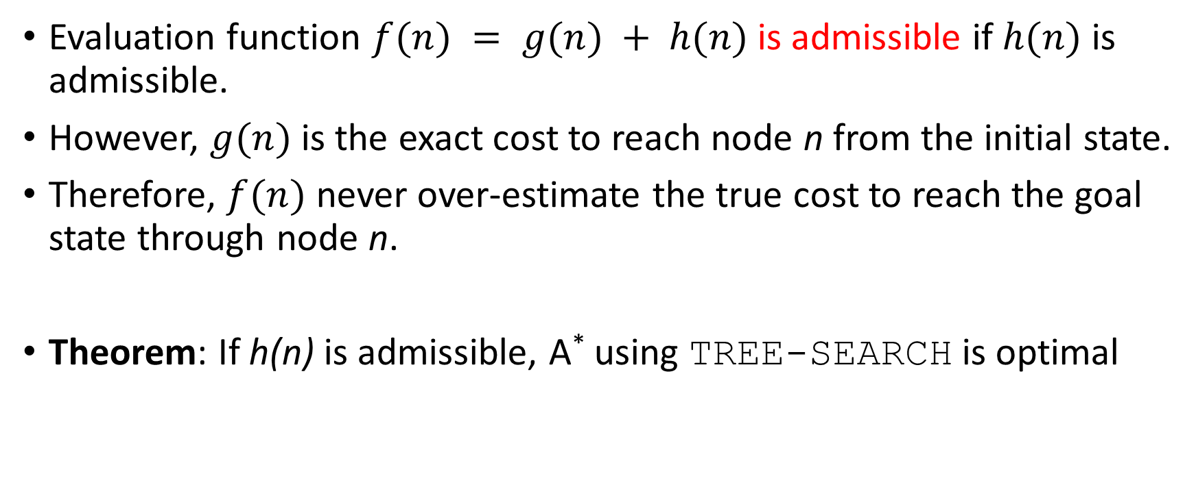
Admissible Heuristic Functions
Evaluation function $f(n) = g(n) + h(n)$ is admissible if $h(n)$ is admissible.
However, $g(n)$ is the exact cost to reach node n from the initial state.
Therefore, $f(n)$ never over-estimate the true cost to reach the goal state through node n.
Theorem: If h(n) is admissible, A* using TREE-SEARCH is optimal

Slide 27

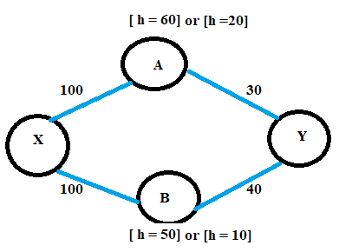
Example

Slide 28
A* Search: if h not admissible
State | Heuristic: h(n)
A | 366
B | 374
C | 329
D | 244
E | 253
F | 178
G | 193
H | 138
I | 0
Start
A
75
118
140
B
C
111
E
D
80
99
G
F
97
H
211
101
I
f(n) = g(n) + h (n) – (H-I) Overestimated
g(n): is the exact cost to reach node n from the initial state.
Goal

Slide 29
A* Search: Tree Search
A
Start

Slide 30
A* Search: Tree Search
A
Start
118
75
140
E
[393]
B
[449]
[447]
C

Slide 31
A* Search: Tree Search
A
Start
118
75
140
E
[393]
B
[449]
[447]
C
80
99
[413]
G
F
[417]

Slide 32
A* Search: Tree Search
A
Start
118
75
140
E
[393]
B
[449]
[447]
C
80
99
[413]
G
F
[417]
97
[455]
H

Slide 33
A* Search: Tree Search
A
Start
118
75
140
E
[393]
B
[449]
[447]
C
80
99
[413]
G
F
[417]
97
211
[455]
I
H
Goal
[450]

Slide 34
A* Search: Tree Search
A
Start
118
75
140
E
[393]
B
[449]
[447]
C
80
99
[473]
[413]
G
F
[417]
D
97
211
[455]
I
H
Goal
[450]

Slide 35
A* Search: Tree Search
A
Start
118
75
140
E
[393]
B
[449]
[447]
C
80
99
[473]
[413]
G
F
[417]
D
97
211
[455]
I
H
Goal
[450]

Slide 36
A* Search: Tree Search
A
Start
118
75
140
E
[393]
B
[449]
[447]
C
80
99
[473]
[413]
G
F
[417]
D
97
211
[455]
I
H
Goal
[450]

Slide 37
A* Search: Tree Search
A
Start
118
75
140
E
[393]
B
[449]
[447]
C
80
99
[473]
[413]
G
F
[417]
D
97
211
[455]
I
H
Goal
[450]
A* not optimal !!!
When heuristic h is not admissible
dist(A-E-F-I) =140+99+211=450

Slide 38
A* Tree Search
State space graph
Search tree
h=4
S (0+2)
1
A
1
h=1
S
C
A (1+4)
C (3+1)
h=2
3
3
C (2+1)
G (6+0)
G (5+0)
G
h=0

Slide 39
Consistency of Heuristics
A
1
Main idea: Estimated heuristic costs ≤ actual costs
Admissibility:
heuristic cost ≤ actual cost to goal
h(A) ≤ actual cost from A to G
Consistency:
“heuristic step cost” ≤ actual cost for each step
h(A) – h(C) ≤ cost(A to C)
triangle inequality
h(A) ≤ cost(A to C) + h(C)
Consequences of consistency:
The f value along a path never decreases
A* graph search is optimal
C
h=4
h=2
h=1
G
But an admissible heuristic is not always consistent

Slide 40
A* Algorithm
1. Search queue Q is empty.
2. Place the start state s in Q with f value h(s).
3. If Q is empty, return failure.
4. Take node n from Q with lowest f value.
(Keep Q sorted by f values and pick the first element).
5. If n is a goal node, stop and return solution.
6. Generate successors of node n.
7. For each successor n’ of n do:
a) Compute f(n’) = g(n) + h(n’).
b) If n’ is new (never generated before), add n’ to Q.
c) If node n’ is already in Q with a higher f value, replace it with current f(n’) and place it in sorted order in Q.
End for
8. Go back to step 3.

Slide 41
function UNIFORM-COST-SEARCH(problem) returns a solution, or failure
initialize the explored set to be empty
initialize the frontier as a priority queue using g(n) as the priority
add initial state of problem to frontier with priority g(S) = 0 loop do
if the frontier is empty then
return failure choose a node and remove it from the frontier if the node contains a goal state then
return the corresponding solution
add the node state to the explored set
for each resulting child from node
if the child state is not already in the frontier or explored set then
add child to the frontier
else if the child is already in the frontier with higher g(n) then
replace that frontier node with child

Slide 42
function A-STAR-SEARCH(problem) returns a solution, or failure
initialize the explored set to be empty
initialize the frontier as a priority queue using f(n) = g(n) + h(n) as the priority
add initial state of problem to frontier with priority f(S) = 0 + h(S) loop do
if the frontier is empty then
return failure choose a node and remove it from the frontier if the node contains a goal state then
return the corresponding solution
add the node state to the explored set
for each resulting child from node
if the child state is not already in the frontier or explored set then
add child to the frontier
else if the child is already in the frontier with higher f(n) then
replace that frontier node with child

Slide 43
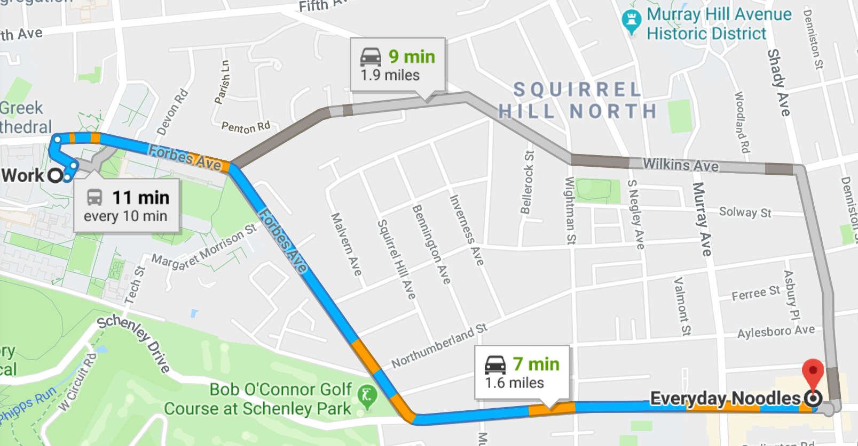
A* Applications
Pathing / routing problems
Resource planning problems
Robot motion planning
Language analysis
Video games
Machine translation
Speech recognition
…

Slide 44
Properties of A*

Slide 45
Properties of A*
Complete? Yes
(unless there are infinitely many nodes with f ≤ f(G) )
Time? Exponential
It depends on the quality of heuristic but is still exponential.
with respect to the length of the solution
better than other algorithms, but still problematic
Space? Keeps all nodes in memory
O(b^{d}) space complexity,
A* keeps all generated nodes in memory
But an iterative deepening version is possible (IDA*).
Optimal? Yes
A* is optimal if heuristic h is admissible (optimal).
Notes:
Also optimally efficient: any search based on h must expand as many nodes as A*. Reason: think of f(n) as saying: this path could lead to the goal as quickly as f(n). So must try it.

Slide 46

Video of Demo Contours

Slide 47

Optimality
Tree search:
A* is optimal if heuristic is admissible
UCS is a special case (h = 0)
Graph search:
A* optimal if heuristic is consistent
UCS optimal (h = 0 is consistent)
Consistency implies admissibility
In general, most natural admissible heuristics tend to be consistent, especially if from relaxed problems

Slide 48
Optimality of A* Graph Search
Sketch: consider what A* does with a consistent heuristic:
Fact 1: In tree search, A* expands nodes in increasing total f value (f-contours)
Fact 2: For every state s, nodes that reach s optimally are expanded before nodes that reach s suboptimally
…
f ≤ 1
f ≤ 2
f ≤ 3

Slide 49
Relationship of Search Algorithms
Notation
g(n) = known cost so far to reach n
h(n) = estimated (optimal) cost from n to goal
f(n) = g(n)+h(n) = estimated (optimal) total cost through n
Uniform cost search: sort frontier by g(n)
Greedy best-first search: sort frontier by h(n)
A* search: sort frontier by f(n)
Optimal for admissible / consistent heuristics
Generally the preferred heuristic search framework
Memory-efficient versions of A* are available: RBFS, SMA*

Slide 50
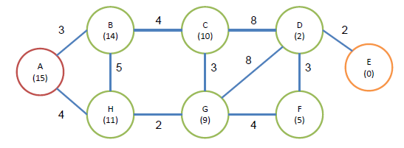
Activity
Perform Uniform Cost Search, the Best-First Search, and the A* algorithm. Here we suppose that A is the initial node, and E is the target. The cost of each edge and the heuristic value of the each node are also given in the figure.

Slide 51
Iterative deepening A* (IDA*)
Iterative deepening A* (IDA*) is a graph traversal and path-finding method that can determine the shortest route in a weighted graph between a defined start node and any one of a group of goal nodes.

Slide 52
It is a kind of iterative deepening depth-first search that adopts the A* search algorithm’s idea of using a heuristic function to assess the remaining cost to reach the goal.
A memory-limited version of A* is called IDA*. It performs all operations that A* does and has optimal features for locating the shortest path, but it occupies less memory.

Slide 53
Difference between IDA* and ID-DFS
Iterative Deepening A Star uses a heuristic to choose which nodes to explore and at which depth to stop, as opposed to Iterative Deepening DFS, which utilizes simple depth to determine when to end the current iteration and continue with a higher depth.

Slide 54
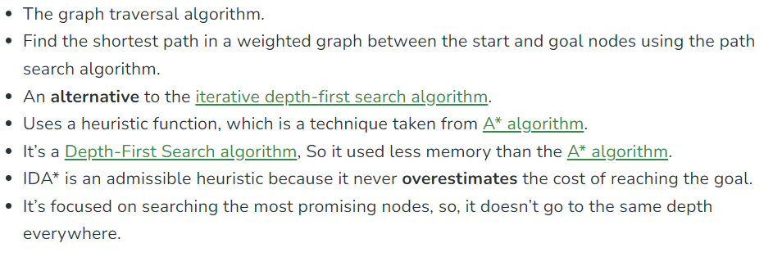
Key points

Slide 55
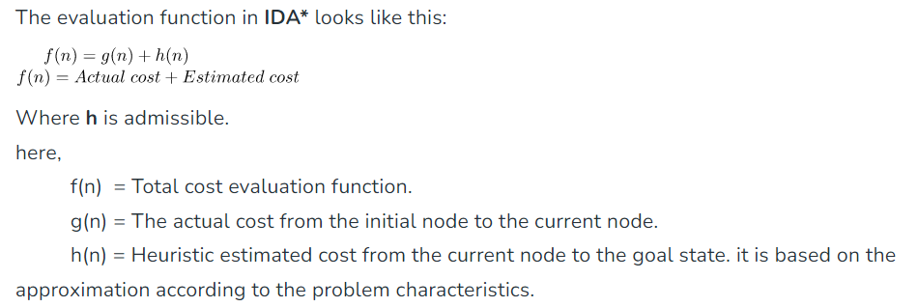
Evaluation Function

Slide 56
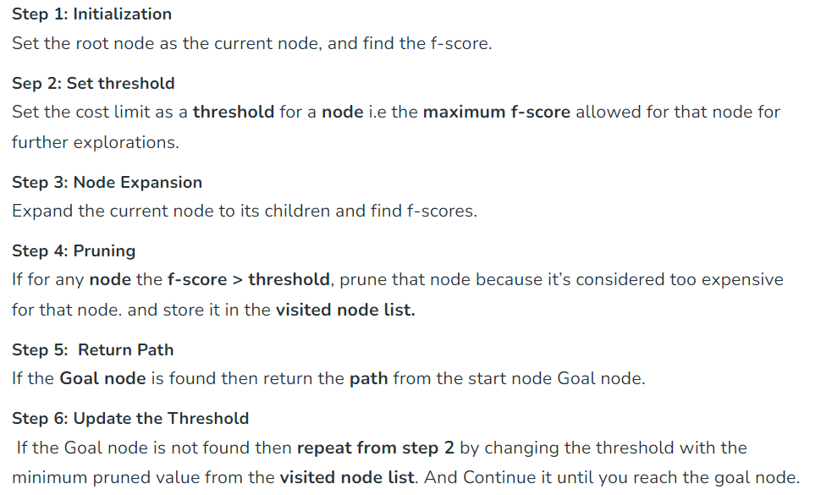
How IDA* works?

Slide 57
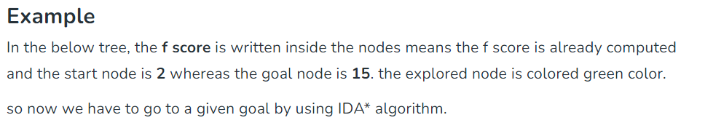

Slide 58
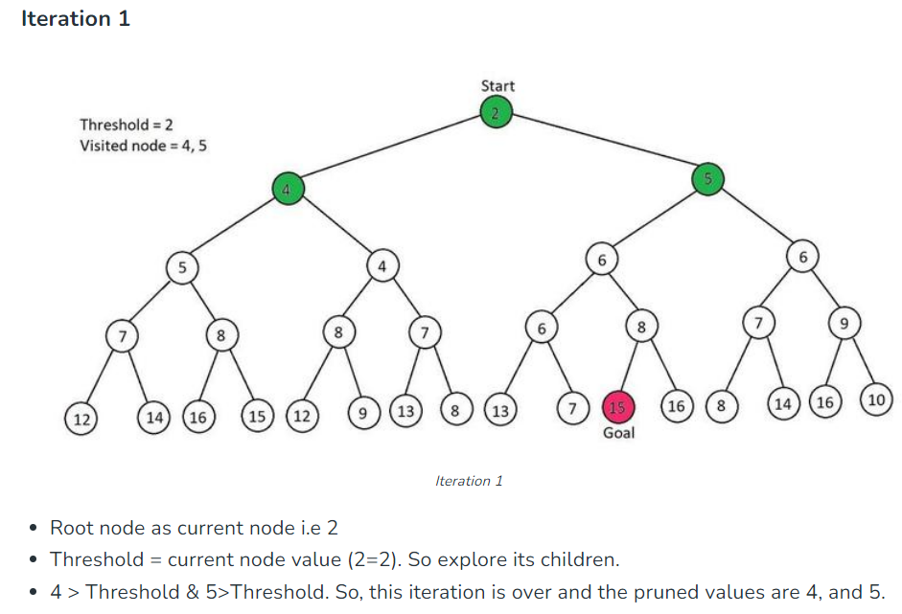

Slide 59
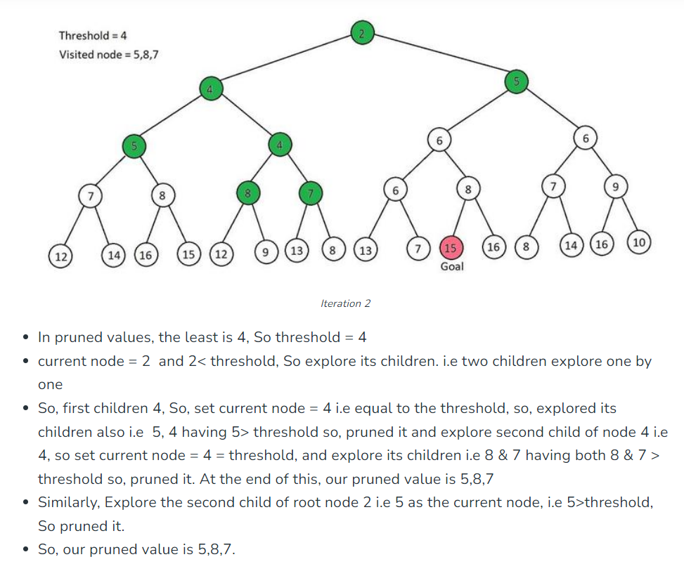
Iteration 2

Slide 60
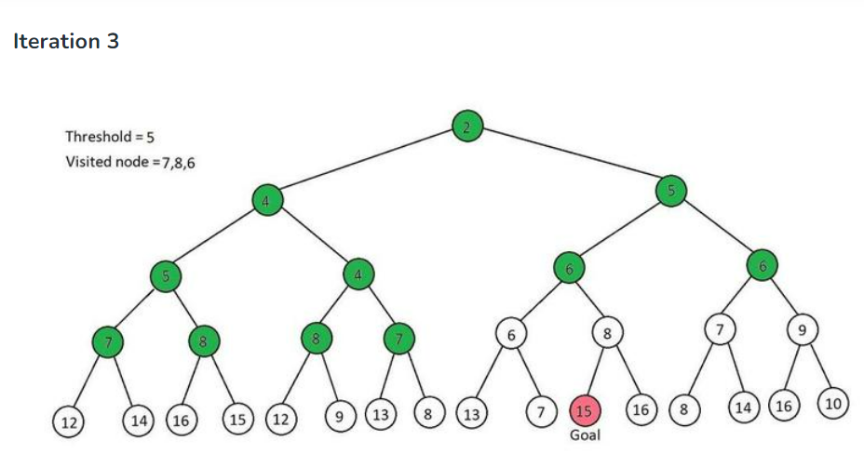
Pruned Values : 7,8,6

Slide 61
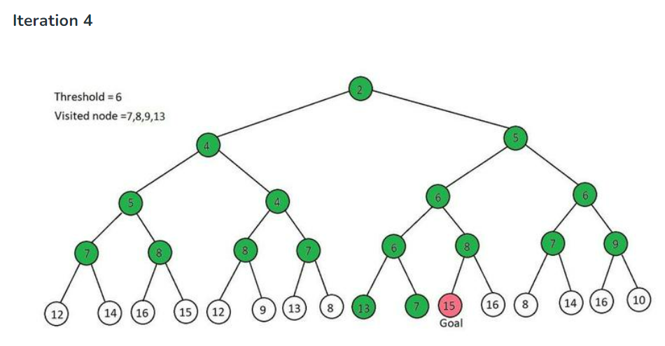
Pruned Values : 7,8,9,13

Slide 62
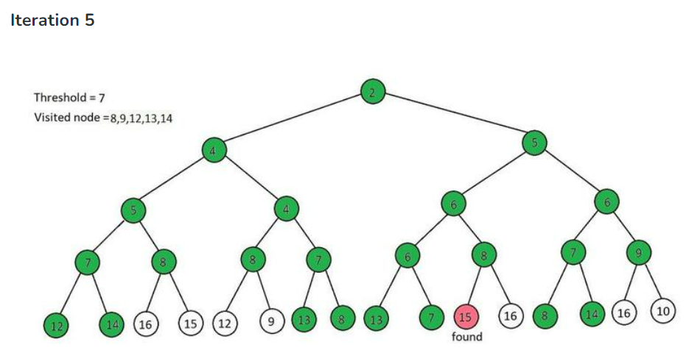
Pruned Values : 8,9,12,13,14

Slide 63
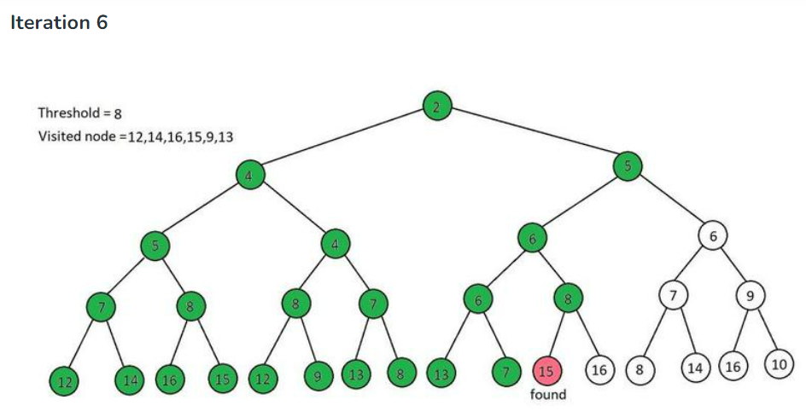
Path : 2,5,6,8,15

Slide 64
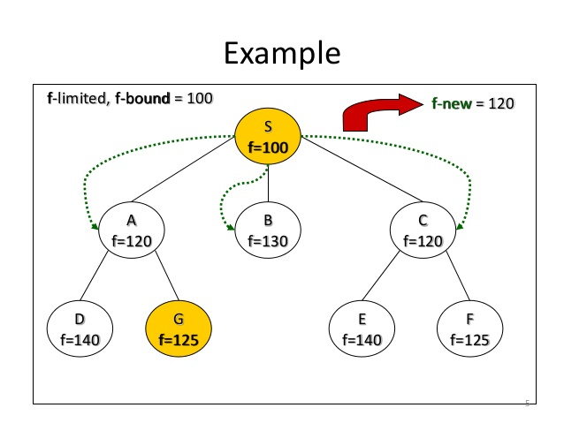
IDA*

Slide 65
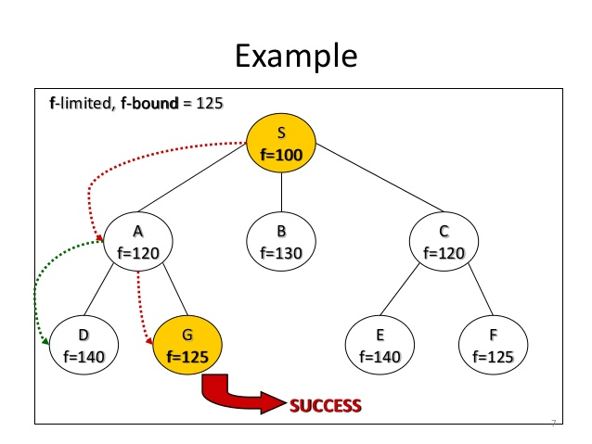
IDA*

Slide 67
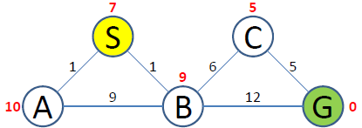
f_bound = 0
f_new = 7
S(7)

Slide 68
f_bound = 7
f_new = 10
S(7)
A(11)
B(10)

Slide 69
f_bound = 10
f_new = 11
S(7)
A(11)
B(10)
C(12)
G(13)

Slide 70
f_bound = 11
f_new =
S(7)
A(11)
B(10)
C(12)
G(13)
C(12)
G(13)

